Slide 1
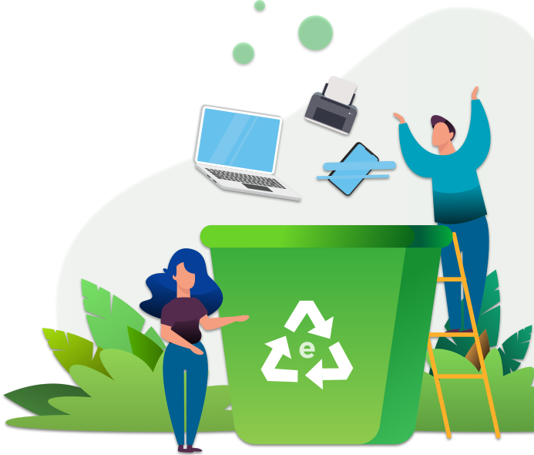
E-Waste Recycling Management (R-E-CYCLE)
Team 2
Asmita Samanta
Harshitha Ramachandra
Kamran Djourshari
Nayab Mahmood
Sakshi Patil
Srikanth Parvathala

Slide 2
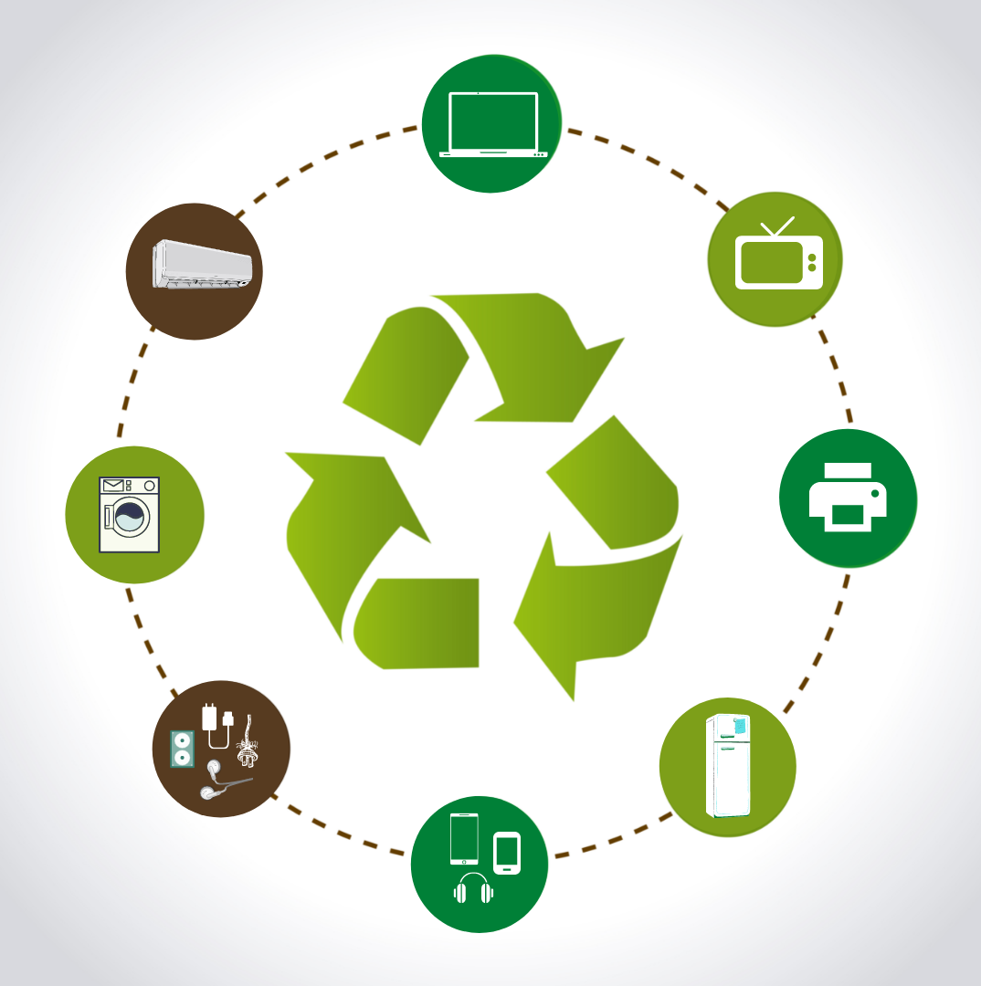
What is E-Waste Recycling Management ?
Collection of e-waste, recover and recycle materials.
R-E-Cycle encourages environmentally conscious choices through award credits/points.
The accumulated credits can be used to buy the refurbished products.
Re-use and educating the public about E-Waste risks and good disposal practices
Notes:
Waste Management has been a pressing issue across the globe with an ever-rising population surge and the utilization of the daily needs including electronics. E-waste refers to any electronic devices that have reached the end of life. They are generally discarded to the waste disposal that gets shipped to dump yards across the globe. We wanted to have the e-waste handled in a much more efficient sense with the urge to have a service that could significantly reduce and recycle the electronic goods after their end of life.
The E-waste Recycling Management System encourages proper processes to collect e-waste and recover and recycle material by safe methods to reduce its adverse impacts on the environment.
Our information service R-E-Cycle encourages environmentally conscious choices through award credits.
The accumulated points can be used to buy the refurbished devices from our service.
It also encourages re-use and educating the public about E-Waste risks and good disposal practices

Slide 3
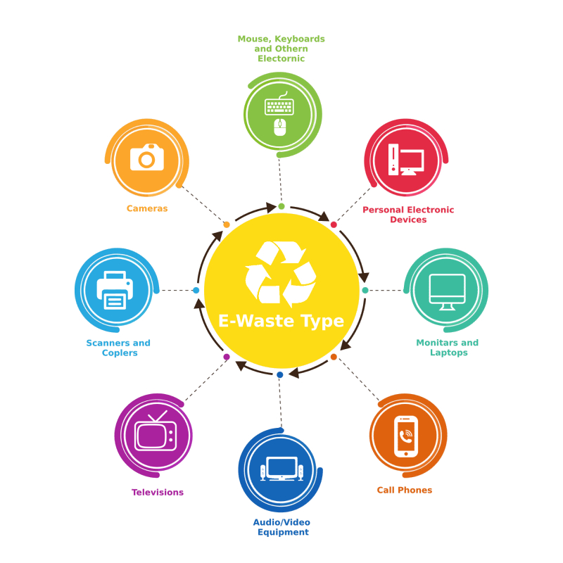
Why is E-Waste Recycling important ?
To keep electronic waste out of landfills.
Materials can be reclaimed.
Re-use of reclaimed valuable materials.
To reduce greenhouse gas emissions.
Notes:
The term e-waste covers a huge range of products: Small equipment like calculators, electric kettles to large equipment like dish-washing machines, solar panels and many more. These items are growing in huge numbers as individuals and businesses are more technology oriented with existing and new equipments. Our E-waste information service is not just individual specific, it is open to businesses. With a world population of 8 billion and with ever growing changes in media and technology, this will not just be a onetime thing as it's a cycle of recycling, refurbishing, and reselling.
Many old electronic devices contain toxic substances. When e-waste is tossed into landfills, these chemicals leach into the soil, polluting the ground water as well as the air.
Reclaiming valuable materials from the recycling process which in turn decreases demand for new raw materials.
Recycling old devices saves energy. With the re-use fewer raw materials need to be drawn from nature to create new devices.
Recycling saves the raw materials that can be repurposed by producing new devices. As a result, energy is saved, pollution is reduced, and there are fewer greenhouse gas emissions released into the atmosphere.

Slide 4
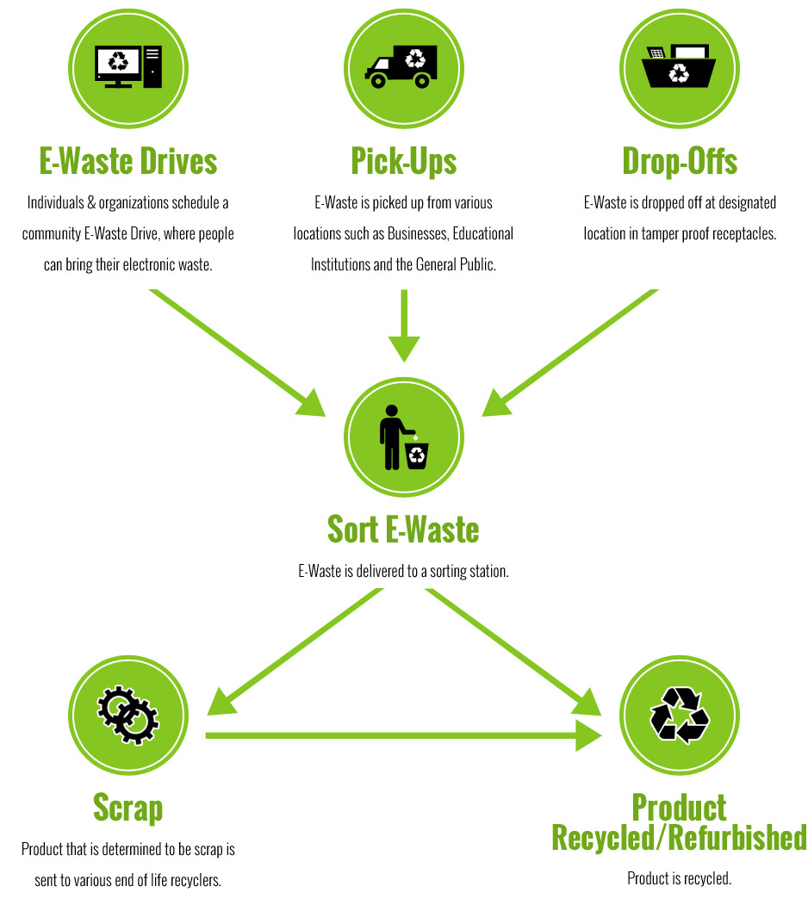
Functions, actions and benefits
Users can create an account and request for the pick up service
Subscribe to email listings for awareness on sustainable living
Users would gain reward points with their action
Refurbished devices on sale can be purchased through the points
Notes:
The first stage in the recycling process for e-waste is the collection of electronic products. With our application, users can create an account for themselves, log in, and lookout for the nearest collection lakes where they can dump their e-waste or request for an on-demand collection service.
Having an account, they will be subscribing to our email listings which would educate them on safe, hygienic disposal practices and awareness about sustainable living.
Adding to the benefits of having an account, users would gain points or rewards with their action which can be redeemed later for buying any refurbished devices from our service. From the collection lakes, the e-waste would go through our next steps of recycling which includes storage, manual sorting, dismantling, shredding, mechanical separation and recovery.
The refurbished electronics devices or parts will be up for sale for the users, and they can purchase through the points gained or as per the requirement.

Slide 5
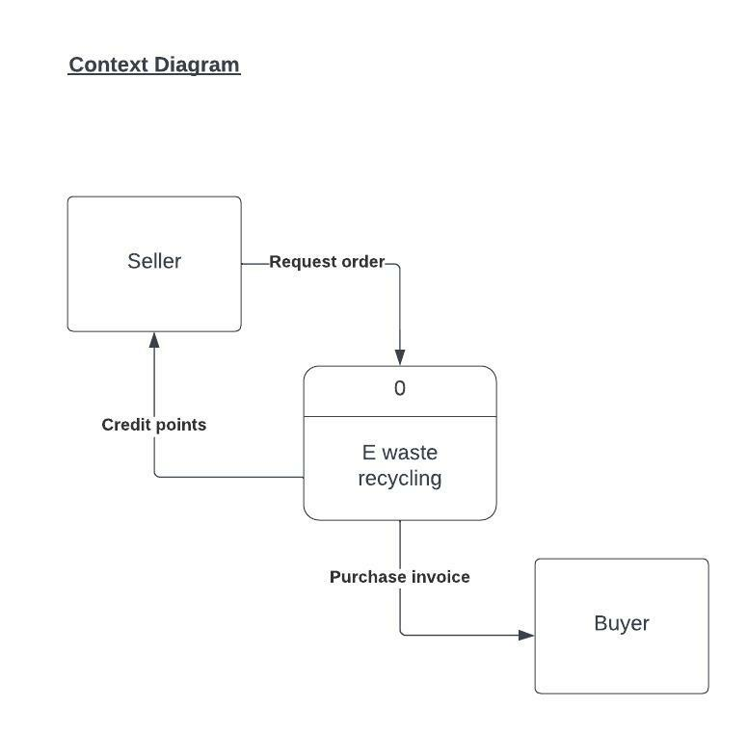
Data Flow Diagram
Context Diagram

Slide 6
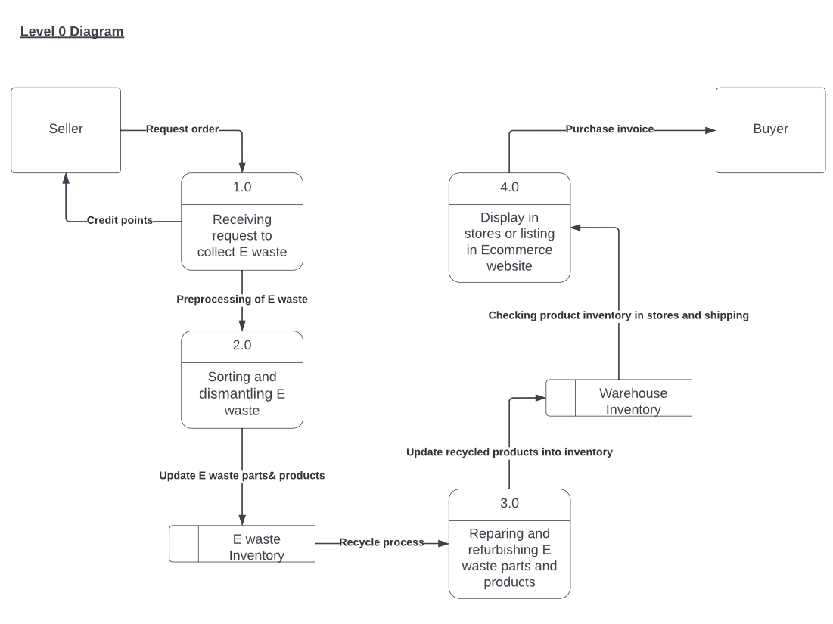
Level 0 Diagram

Slide 7
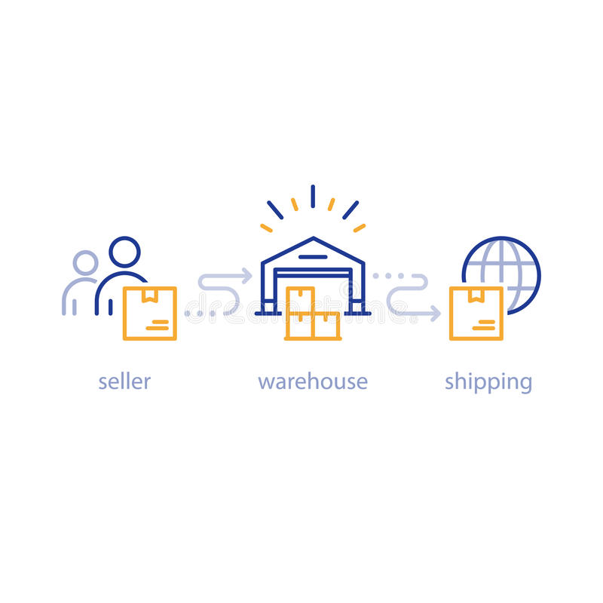
Entity Relationship Diagram
Displaying process of retrieval, refurbishment, and selling
Prioritize having multiple warehouses around the country
Refurbished in warehouse after retrieving from consumer
Users purchase fixed product in a recycle flow method

Slide 8
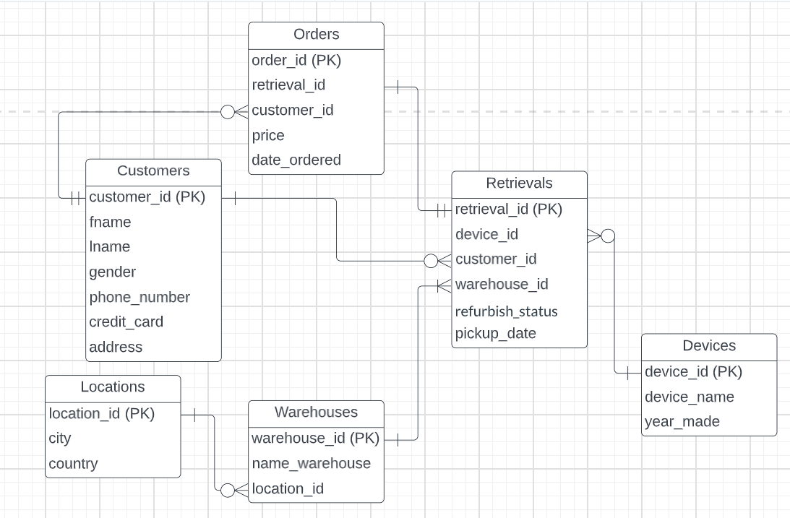
Entity Relationship Diagram (ERD)

Slide 9
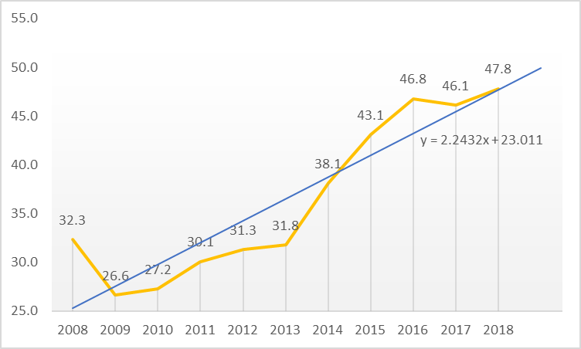
Data Visualization
Reuse and Recycling Rate (y-axis) = Weight of the WEEE that enters the recycling/preparing for re-use facility / Weight of all separately collected WEEE (both in mass unit)

Slide 10
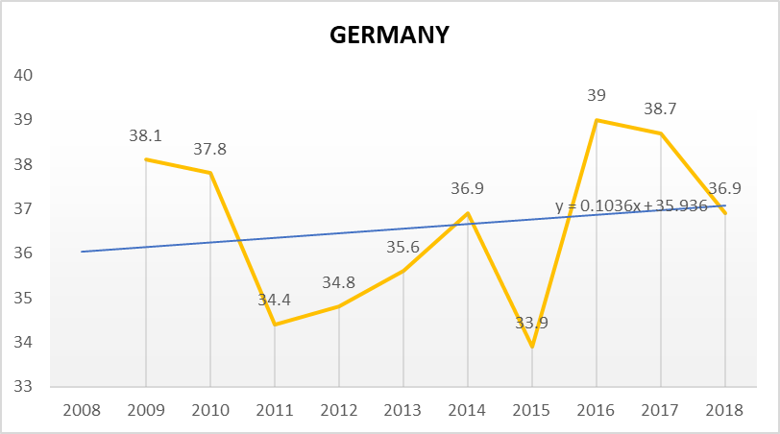
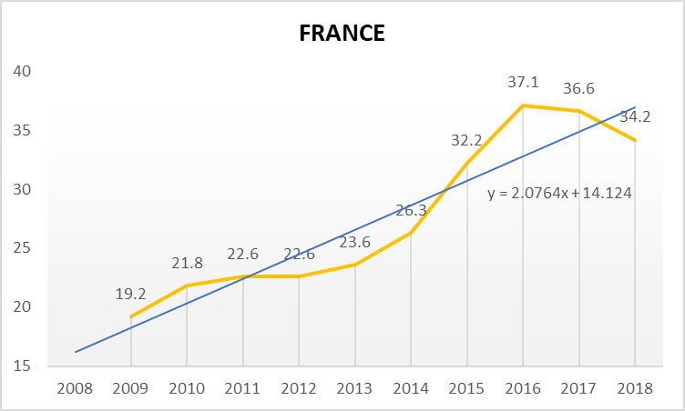
Data Visualization

Slide 11
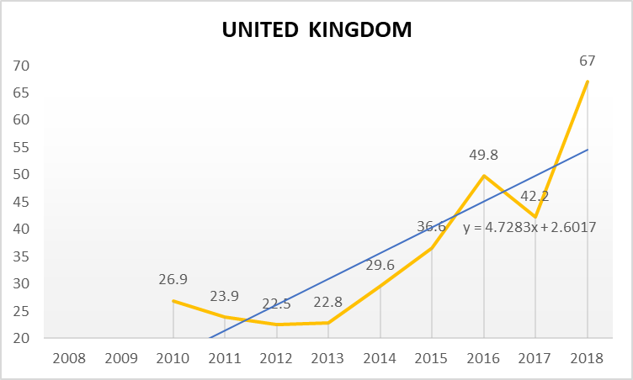
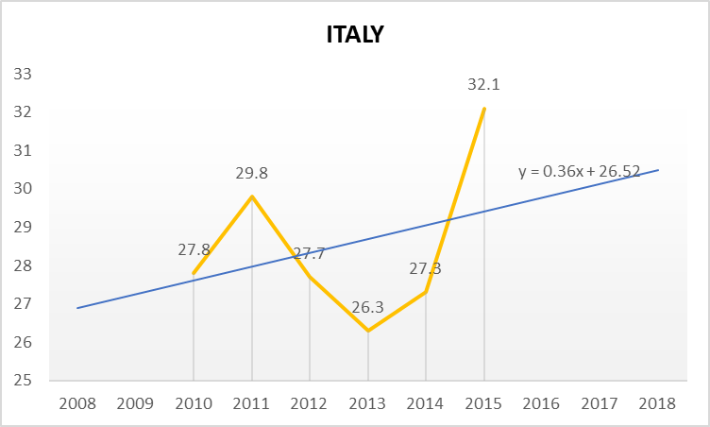
Data Visualization

Slide 12
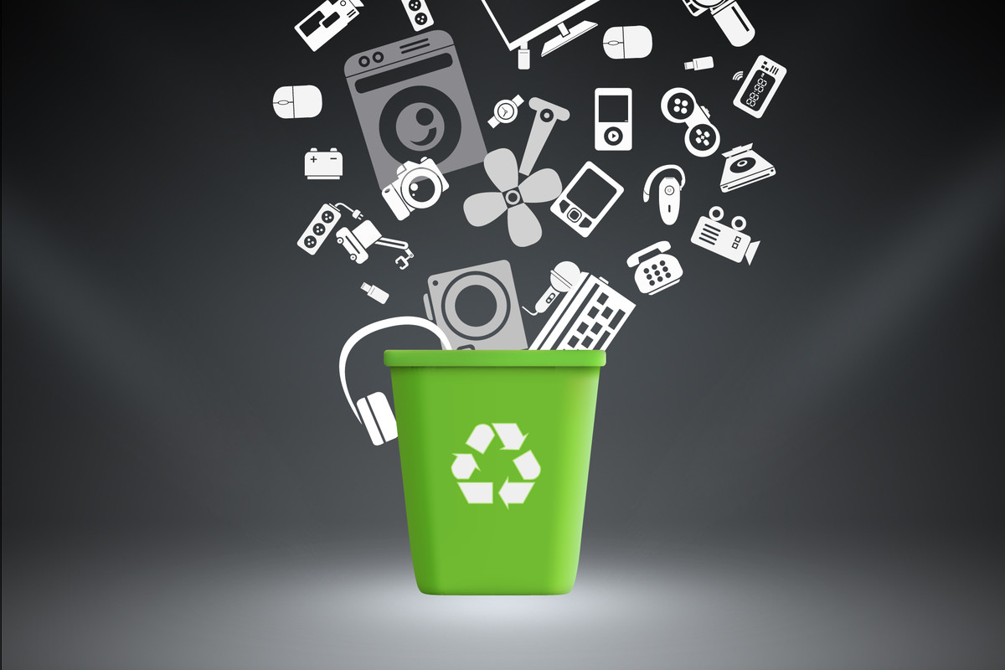
R-E-CYCLE
WIREFRAMES

Slide 13


Slide 14
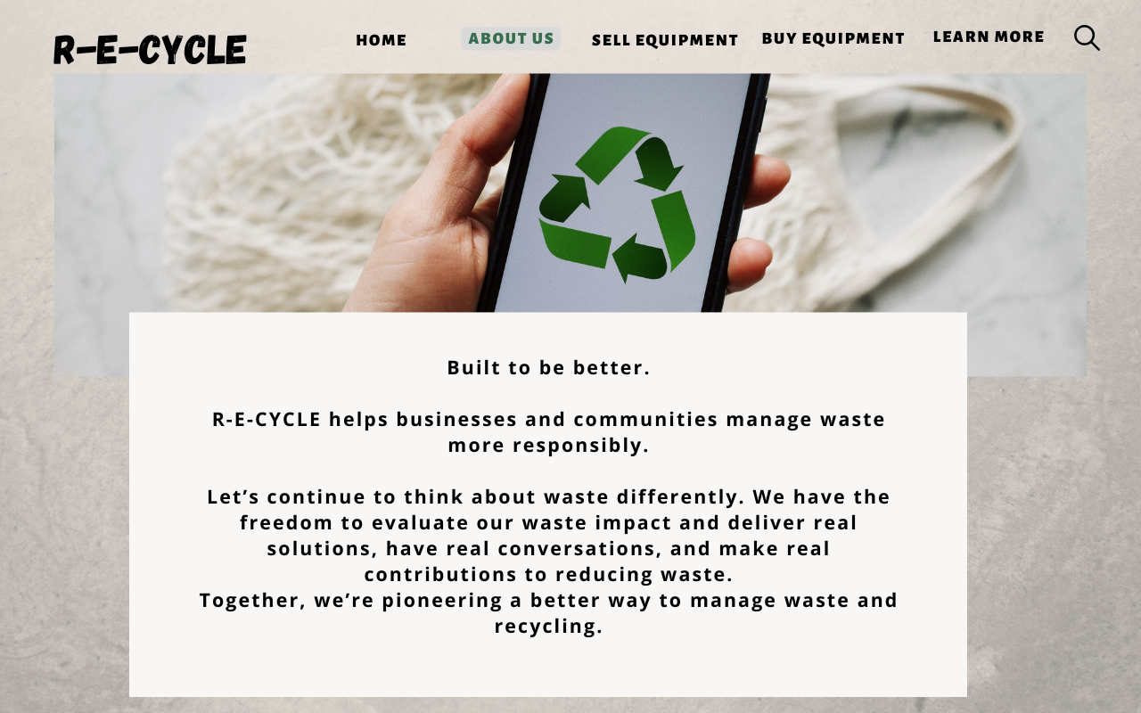

Slide 15
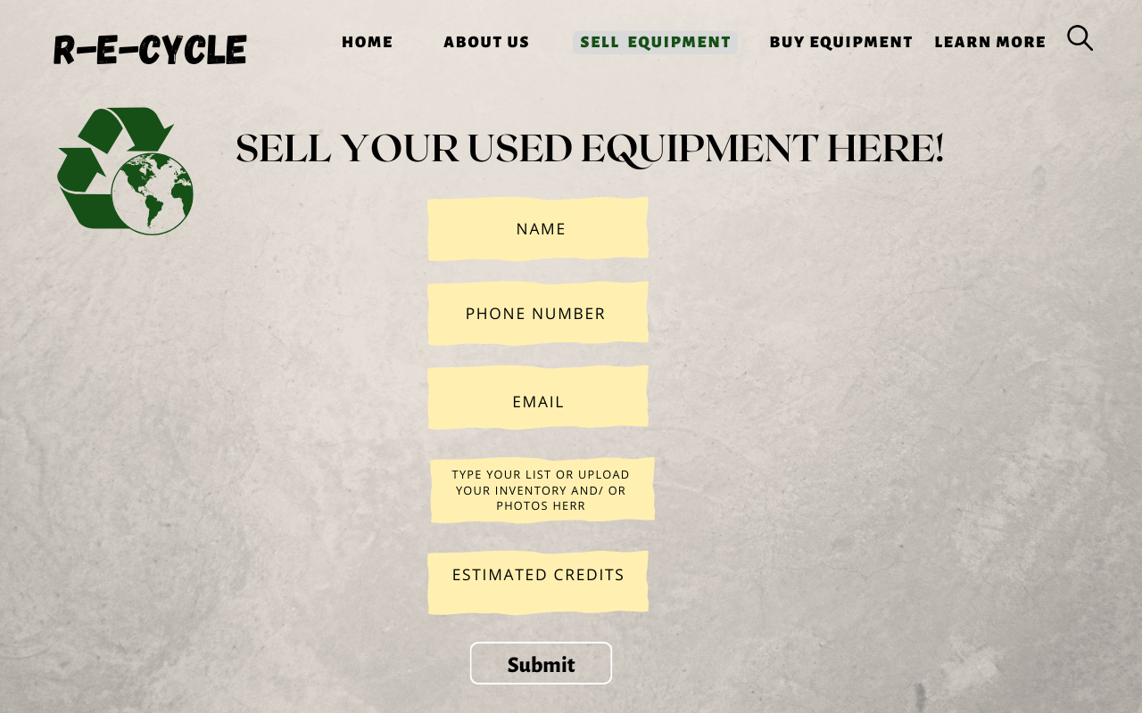

Slide 16
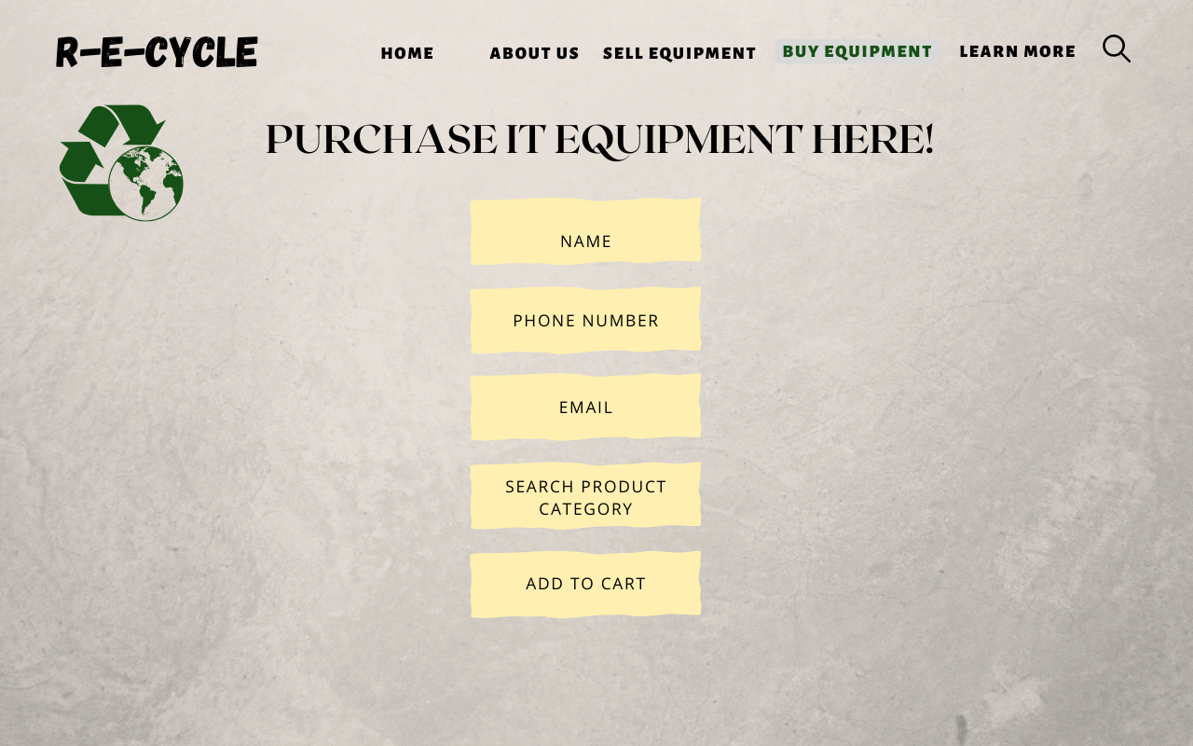

Slide 17
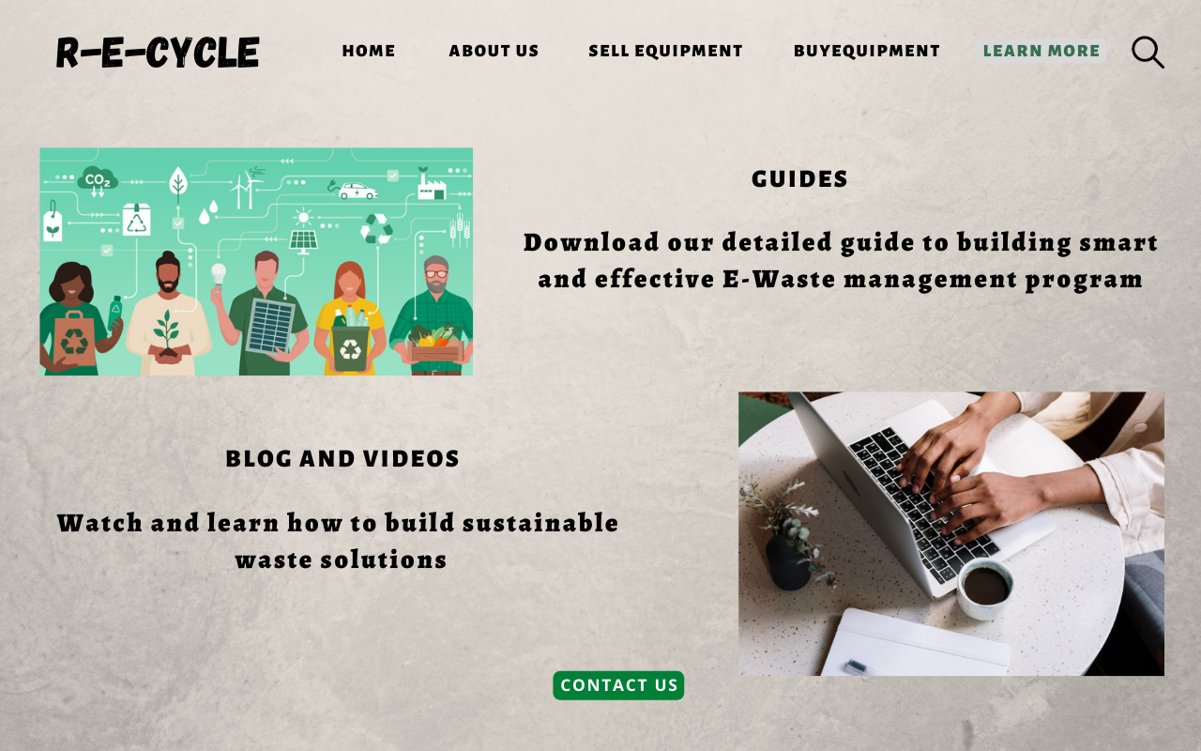

Slide 18
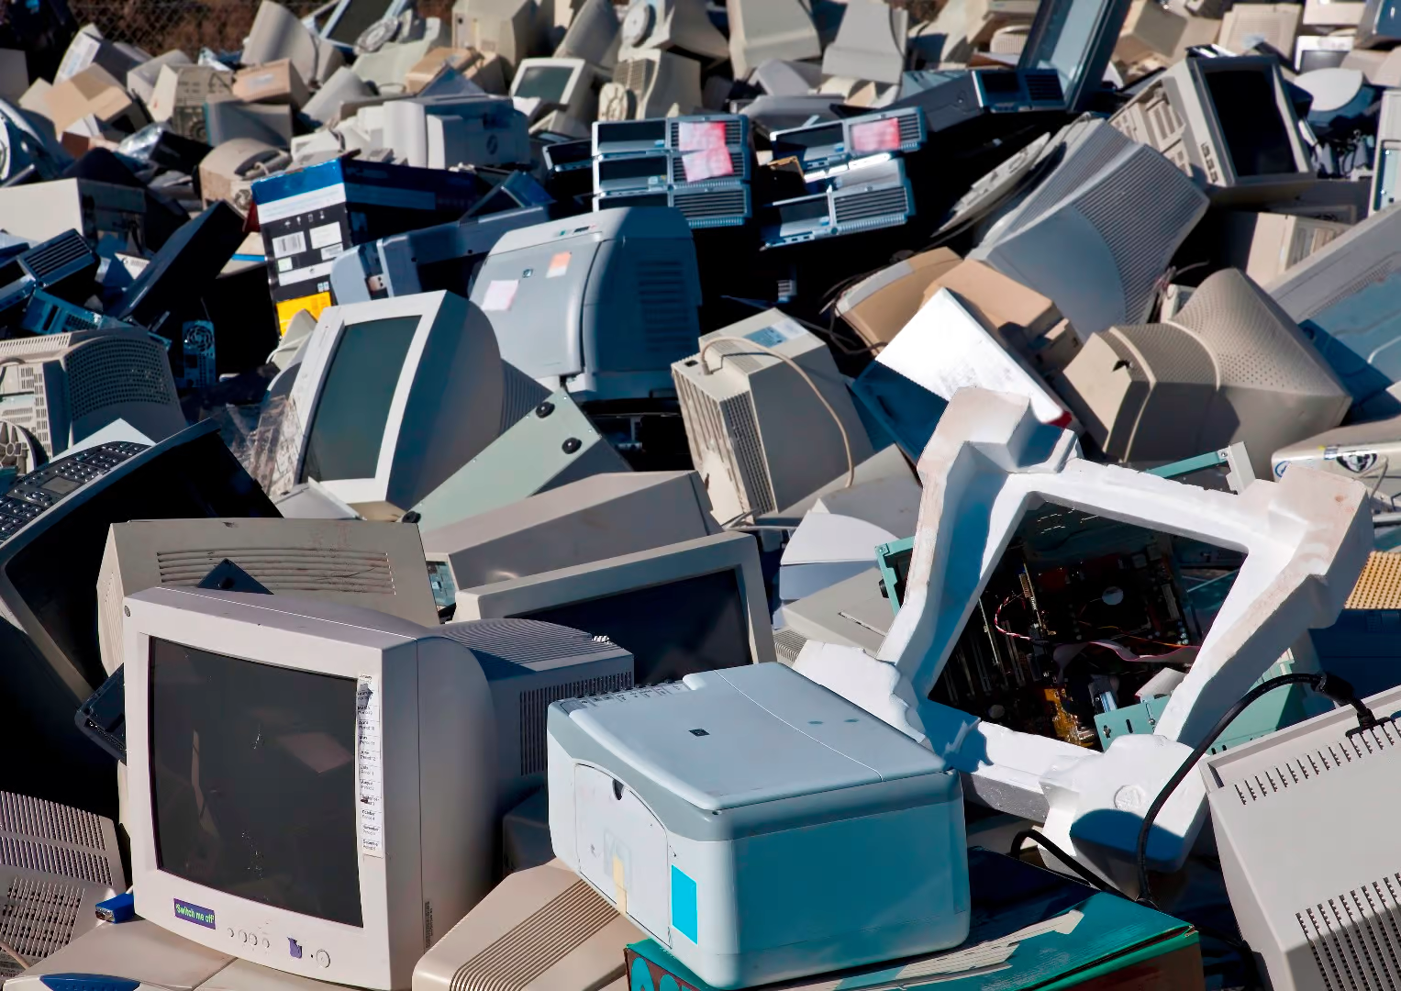
Conclusion
Having a user friendly platform will encourage more people to partake in e-waste recycling
Beneficial for all parties involved
We also strive to educate through our platform
Encouraging users to be more environmentally conscious
Notes:
To conclude, we believe that our system is very beneficial for all parties involved since users are also gaining from recycling and are also able to purchase the refurbished materials . Not only are we conducting the e-waste operations, we are also sending out the emails about sustainability, which allow users to be more educated and also more conscious about the waste that they produce. In this day and age, majority of the population own digital devices, so producing e-waste is inevitable. With our platform we strive to create a system which really encourages and educates users to live their lives with more of a consciousness for environmental impacts.

Slide 19
REFERENCES
https://www.rts.com/blog/the-complete-e-waste-recycling-process/
Canva for creating wireframes: https://www.canva.com/

Slide 20
THANK YOU!

